Slide 1


Sentimental Analysis for Twitter
Made By: Adit Dhall, Sandeep Mamidala, Hughann Plucena, Jaiveer Kapadia

Slide 2

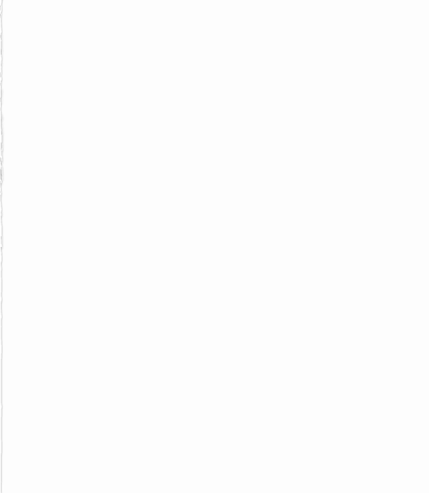
Manifesto
We believe that everyone in the group contributed equally to this project. While doing the practical work we were all together on Zoom, but it was done on Adit’s PC since he was already registered for the educational account. As for the report, we had divided the work amongst ourselves.

Slide 3
Table of Content
Summary of Problem
Data Mining Techniques and Algorithms
Dataset
Pre-Processing
Experimental Setup
Analysis Result
Recommendations

Slide 4
Summary of Problem
We as a group had decided to create a Sentiment Analysis of one of the biggest social media platforms, namely Twitter. Our aim was to extract data on specific hashtags and analyze whether the tweets that had been gathered were positive, negative or neutral tweets in terms of sentiment.
Notes:
Adit - About a month back Indian government decided to pass a bill which stated that the farmers would not require any mediator to sell their crops for them in the market. Government thought that this bill is in favor of the farmers as they could now directly sell the crops in market and they could save the money that they used to pay the mediators. But somehow the farmers thought differently, and they felt that this bill was not beneficial for them. So, they started protesting about the bill and asked government to retract the bill. Because of this protest two of the well-known bollywood: Diljit Dosanjh and Kangana Ranaut. caused an explosion on Twitter by publicly arguing back and forth on the social media platform. Diljit favors the protest, whereas Kangana is against the protest. As a group we decided to do a sentiment analysis on twitter in order to know which actor has more supporters and also know that what do people think about this bill. The result of this could be used to find out how many people are reacting to this issue.

Slide 5
Data Mining Techniques and Algorithms
VADER Sentiment Analysis. VADER (Valence Aware Dictionary and Sentiment Reasoner) is a lexicon and rule-based sentiment analysis tool that is specifically attuned to sentiments expressed in social media.
Notes:
Jaiveer, adit, sandeep - vader_lexicon.txt
Sentiment ratings from 10 independent human raters (all pre-screened, trained, and quality checked for optimal inter-rater reliability). Over 9,000 token features were rated on a scale from "[–4] Extremely Negative" to "[4] Extremely Positive", with allowance for "[0] Neutral (or Neither, N/A)". We kept every lexical feature that had a non-zero mean rating, and whose standard deviation was less than 2.5 as determined by the aggregate of those ten independent raters. This left us with just over 7,500 lexical features with validated valence scores that indicated both the sentiment polarity (positive/negative), and the sentiment intensity on a scale from –4 to +4. For example, the word "okay" has a positive valence of 0.9, "good" is 1.9, and "great" is 3.1, whereas "horrible" is –2.5, the frowning emoticon :( is –2.2, and "sucks" and it's slang derivative "sux" are both –1.5.

Slide 6
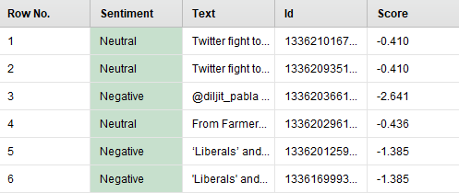
Dataset
Our dataset consists of Five attributes:
Row No.
ID
Text
Score
Sentiment
Notes:
jaiveer

Slide 7
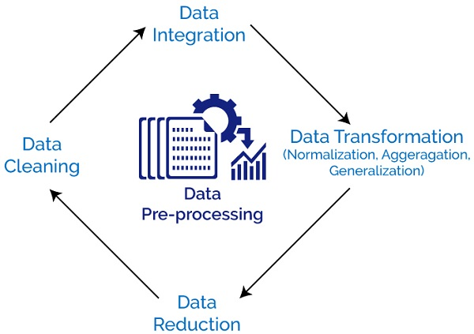
Pre-Processing
Data Reduction
Data Integration
Notes:
hughann

Slide 8
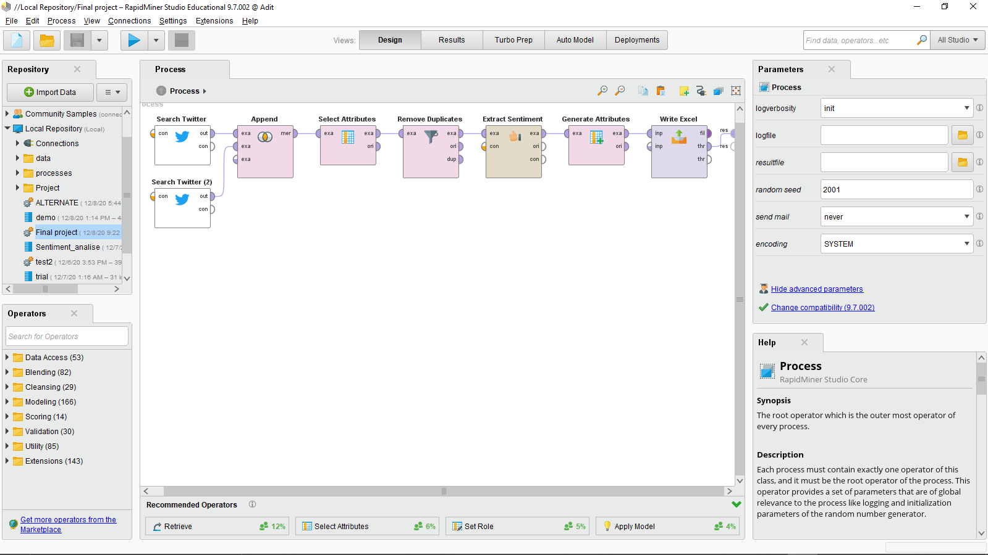
Experimental Setup
Notes:
Sandeep, adit demo

Slide 9
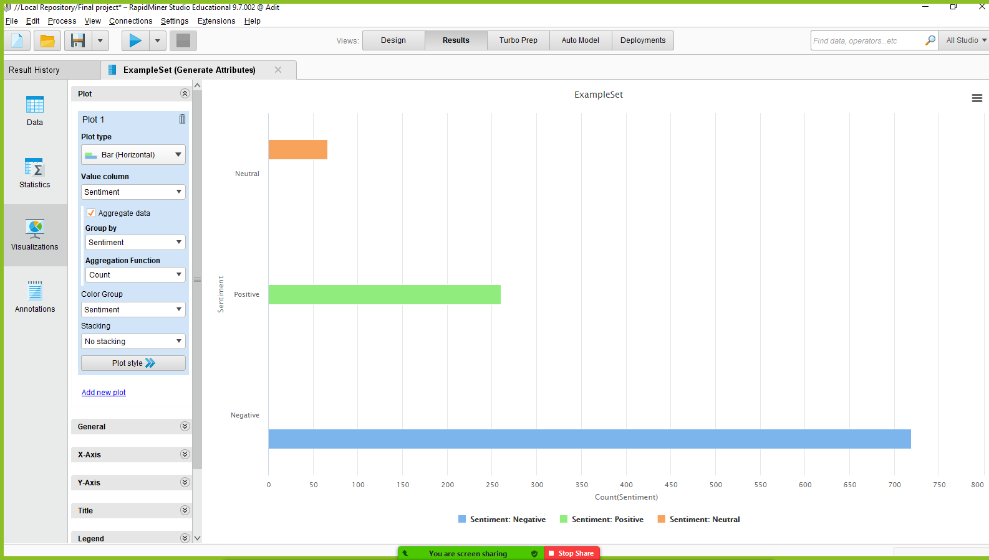
Analysis Results
Notes:
Sandeep

Slide 10
Recommendations
Using APIs is a better option than to train a model as it would require a very high computing power.
Open-source APIs are better than commercial APIs:
We’ve learnt that it’s a good practice to check the outputs that we get for each operator in RapidMiner in order to avoid wrong attribute errors.
Notes:
Jaiveer, hughann

Slide 11
Thank You

